Slide 1
Topic: Multiplying Fractions
EQ: How do we multiply fractions?
Ms. Latham

Slide 2
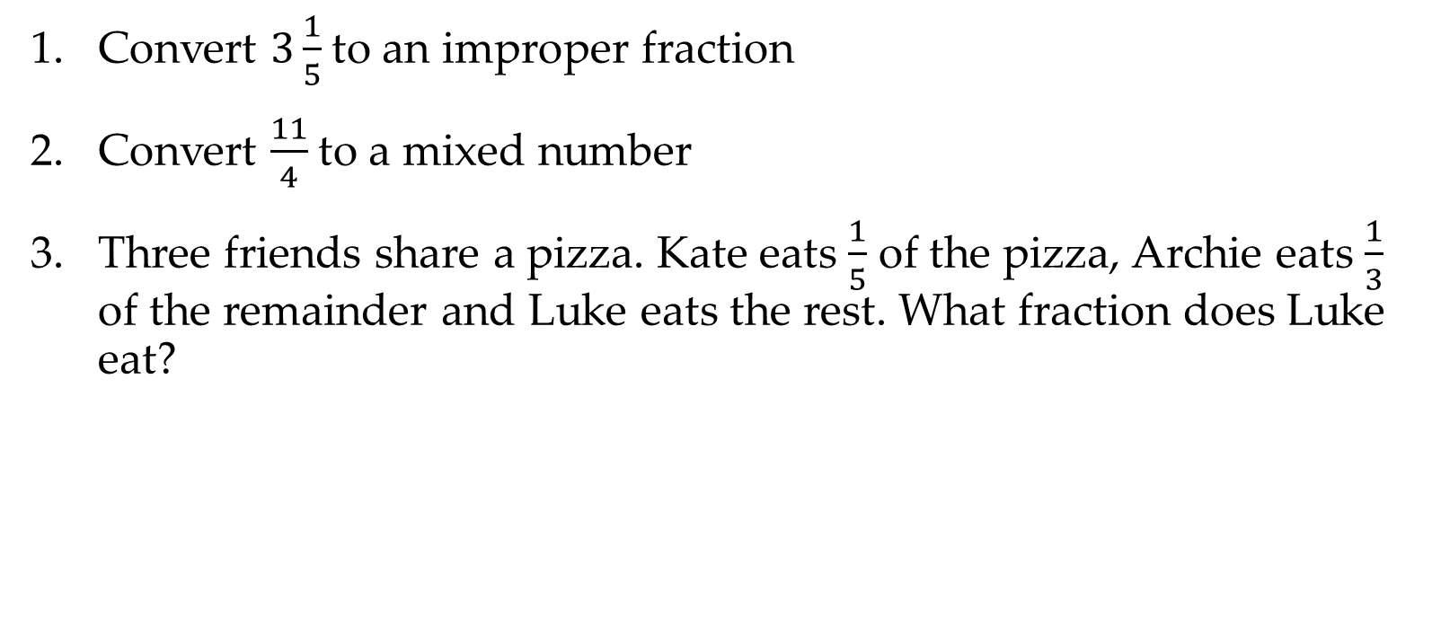
Warm Up Questions:
Convert $3\frac{1}{5}$to an improper fraction
Convert $\frac{11}{4}$to a mixed number
Three friends share a pizza. Kate eats $\frac{1}{5}$ of the pizza, Archie eats $\frac{1}{3}$ of the remainder and Luke eats the rest. What fraction does Luke eat?

Slide 3


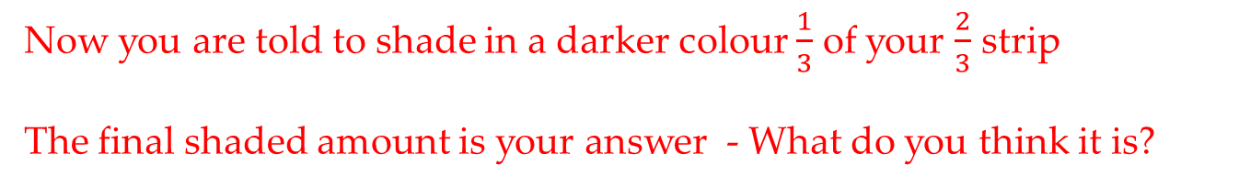
Topic: Multiplying Fractions
EQ: How do I multiply fractions?
The Strip Method
If you had a strip of paper and you shaded $\frac{2}{3}$ of the strip
Now you are told to shade in a darker colour $\frac{1}{3}$ of your $\frac{2}{3}$ strip
The final shaded amount is your answer - What do you think it is?
$$\frac{2}{9}$$
Notes:
Write the outcome on the board $\frac{1}{3}×\frac{2}{3}=\frac{2}{9}$
Do this for each method to see if any kids get the ‘pattern’ before the written method.

Slide 4
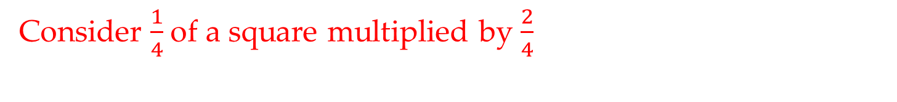
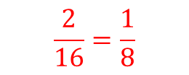


Topic: Multiplying Fractions
EQ: How do I multiply fractions?
The Shading method
Consider $\frac{1}{4}$of a square multiplied by $\frac{2}{4}$
$$×$$
$$=$$
The overlap area is the answer – what is the value?
$$\frac{2}{16}=\frac{1}{8}$$
Notes:
Write the outcome on the board $\frac{1}{4}×\frac{2}{4}=\frac{2}{16}=\frac{1}{8}$
Do this for each method to see if any kids get the ‘pattern’ before the written method.

Slide 5
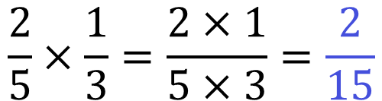
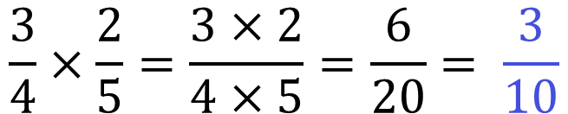
Topic: Multiplying Fractions
EQ: How do I multiply fractions?
Are there any patterns between the fractions being multiplied and the answer fraction?
The rule method
Multiply the numerator together and multiply the denominators together
Then simplify if you can
$$\frac{2}{5}×\frac{1}{3}=\frac{2×1}{5×3}=\frac{2}{15}$$
$$\frac{3}{4}×\frac{2}{5}=\frac{3×2}{4×5}=\frac{6}{20}= \frac{3}{10}$$

Slide 6

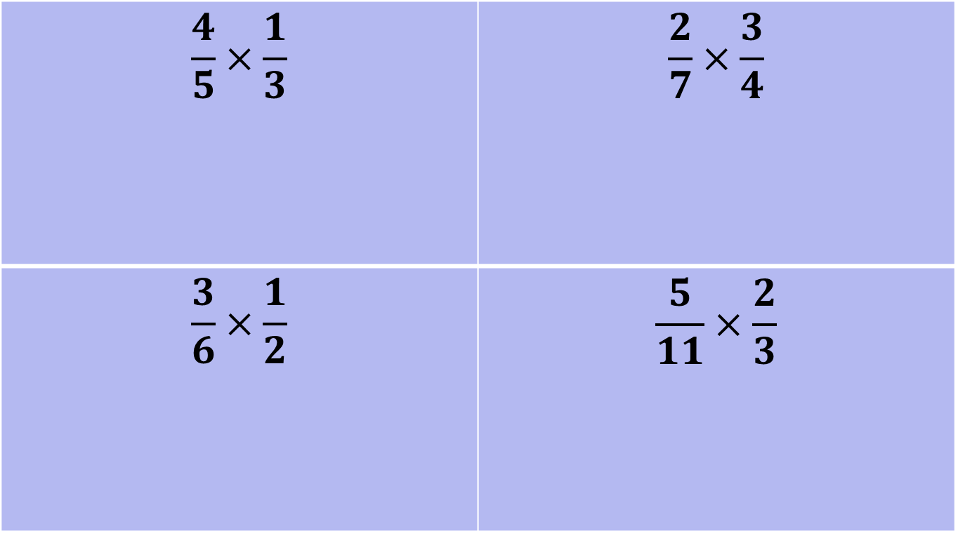
Practice Time!
On your left hand side
$$\frac{4}{5}×\frac{1}{3}$$ | $$\frac{2}{7}×\frac{3}{4}$$
$$\frac{3}{6}×\frac{1}{2}$$ | $$\frac{5}{11}×\frac{2}{3}$$

Slide 7
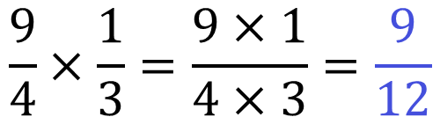

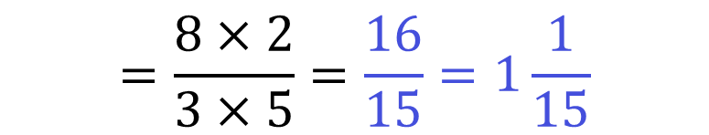
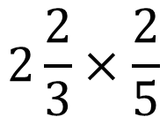
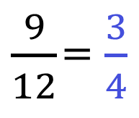
Topic: Multiplying Fractions
EQ: How do I multiply fractions?
What about whole numbers, improper fractions, and mixed fractions?
Improper fractions
Same rule! Just more simplifying at the end!
$$\frac{9}{4}×\frac{1}{3}=\frac{9×1}{4×3}=\frac{9}{12}$$
simplified
$\frac{9}{12}$ = $\frac{3}{4}$
mixed fractions
Convert to improper fraction and follow the rule
$$2\frac{2}{3}×\frac{2}{5}$$
convert
$$\frac{8}{3}×\frac{2}{5}$$
$$=\frac{8×2}{3×5}=\frac{16}{15}=1\frac{1}{15}$$

Slide 8
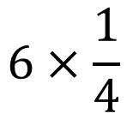

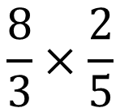

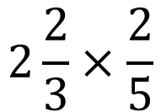
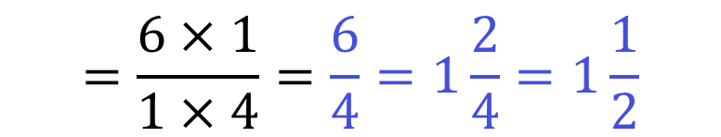
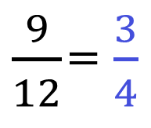
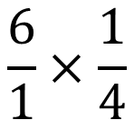
Topic: Multiplying Fractions
EQ: How do I multiply fractions?
Improper fractions
Same rule! Just more simplifying at the end!
$$\frac{9}{4}×\frac{1}{3}=\frac{9×1}{4×3}=\frac{9}{12}$$
simplified
$\frac{9}{12}$ = $\frac{3}{4}$
Mixed fractions
Convert to improper fraction and follow the rule
$$2\frac{2}{3}×\frac{2}{5}$$
convert
$$\frac{8}{3}×\frac{2}{5}$$
$$=\frac{8×2}{3×5}=\frac{16}{15}=1\frac{1}{15}$$
Whole numbers
Whole numbers can be written with a denominator of 1. (this is because anything divided by 1 is itself)
$$6×\frac{1}{4}$$
convert
$$\frac{6}{1}×\frac{1}{4}$$
$$=\frac{6×1}{1×4}=\frac{6}{4}=1\frac{2}{4}=1\frac{1}{2}$$

Slide 9
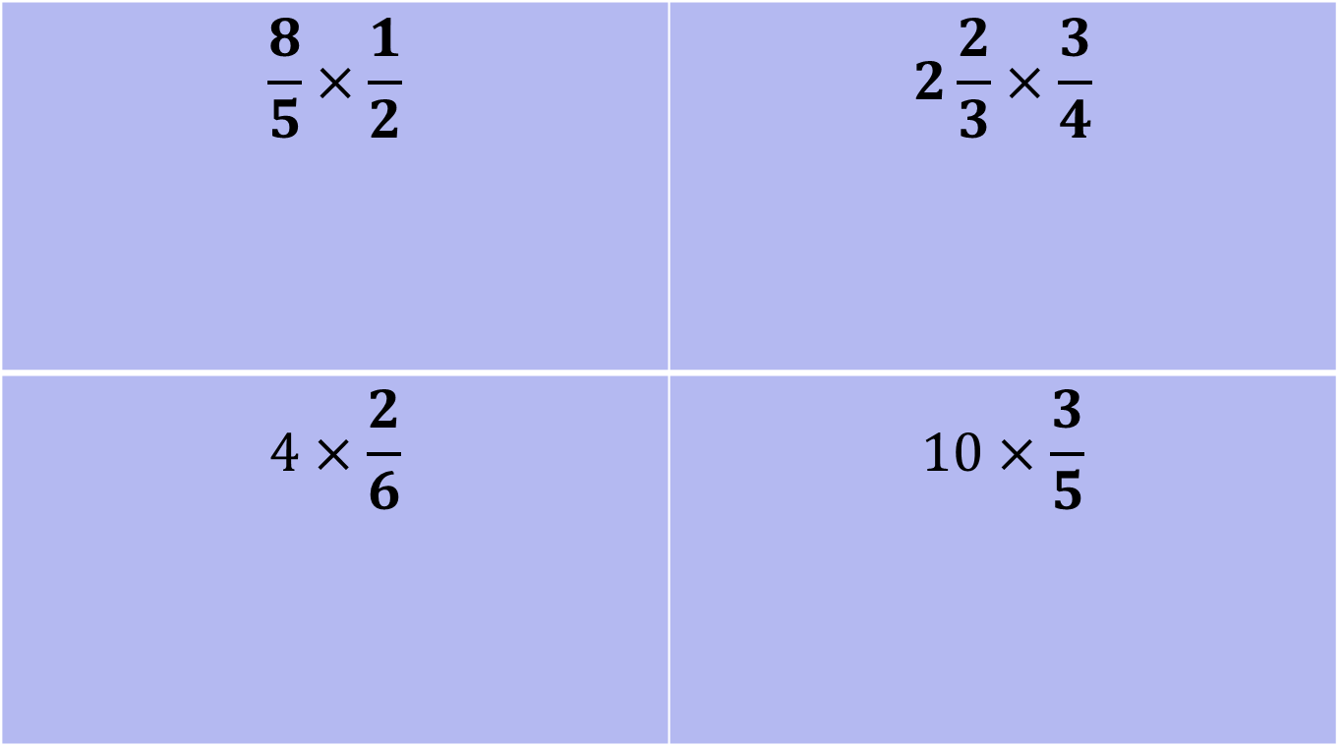
Practice Time!
On your left hand side
$$\frac{8}{5}×\frac{1}{2}$$ | $$2\frac{2}{3}×\frac{3}{4}$$
$$4×\frac{2}{6}$$ | $$10×\frac{3}{5}$$

Slide 10
https://youtu.be/4ghdMifXuFE

Slide 11
Summary
To multiply fractions we need to first _______________________, then we need to ________________________. The final step would be to ______________________.

